Slide 1


Nelson Amaro
13/07/2024

Slide 2

Outline
Executive Summary
Introduction
Methodology
Results
Conclusion
Appendix

Slide 3
Executive Summary
Summary of methodologies
Collecting data using SpaceX REST API and Web Scraping;
Wrangling data to find patterns and to label supervised trained models;
Explore data through some key factors, like payload, orbit, launch site, etc;
Analyze data using SQL;
Explore launch site success rates;
Visualize launch sites with the most success;
Build models in order to predict landing outcomes.

Slide 4
Introduction
Space tourism is relatively new, so there is a lot of market for big tech companies to explore in this field, like SpaceX or Virgin Galactic, for instance. Today, this sort of tourism is only given access to a very few group of people.
The next steps envelop making this sector more affordable and safer for people who dream of seeing the blue Earth from ‘the outside’ and make space travel cheaper for the companies themselves.
Data modelling can have a huge impact in achieving these goals as it attempts to prevent and foretell the success and costs of such endeavors.
One of the major issues presented to space tourism providers is the ability to predict whether the the first stage of a rocket lauch can be landed successfully and reused for future launches decreasing the overall cost of a rocket launch into outer space.

Slide 5

Section 1

Slide 6
Methodology
Collecting data resorting to the SpaceX REST API and web scraping technicques;
Wrangling data by filtering, dealing with missing values and using one hot encoding, thus preparing data to be worked and modelled;
Exploring data with SQL and visualization tools like Matplotlib;
Visualizing data with Folium and Dash;
Building predictive and classification models.

Slide 7
Data Collection – SpaceX REST API
First, we imported the necessary libraries – request, pandas, numpy and datetime;
From getresquest, we requested data from the SpaceX REST API;
Next, we decoded the response using .json();
All the information in the json file was normalized and turned into a dataframe;
We extracted information from the API again using functions, like getBoosterVerson, getLaunchSite, getPayLoadData and getCoreData;
With that information, we created then a dictionary, called ‘launch_dict’;
‘launch_dict’ was transformed into a DataFrame called ‘df’;
Filtered some information and replaced the missing values in ‘PayLoadMass’ column with its mean value

Slide 8
Data Collection – SpaceX API
Flowchart – Data Collection SpaceX REST API
GitHub URL
https://github.com/junioramaro/final_project/blob/main/jupyter-labs-spacex-data-collection-api.ipynb
SpaceX REST API
Decoding response through .json() into DataFrame
Use of functions to get information from the API
Creation of a dictionary
Conversion into another DataFrame

Slide 9
Data Collection - Scraping
Steps:
1. From Wikipedia, Falcon 9 launch data was requested;
BeautifulSoup object was created from An HTML response
Column names were extracted from HTML table header
HTML tables were parsed to collect data
Created dictionary from the data
From the dictionary, created a DataFrame
Exported data to a CSV file
https://github.com/junioramaro/final_project/blob/main/data_collection_web_scraping_lab.ipynb
Falcon 9 Launch data request
Column names extracted
Parsing of column names
Dictionary using the data
DataFrame from the Dictionary
CSV file

Slide 10
Data Wrangling
Steps:
Calculate:
Number of launches at each site;
Number and occurrence at each orbit;
Number and occurrence of mission outcome per orbit type
Create binary landing outcome:
True ocean – mission outcome landed successfully in a specific part of the ocean;
False ocean – mission outcome landed unsuccessfully in a specific part of the ocean;
False RTLS – mission outcome landed successfully on a ground pad;
True RTLS – mission outcome landed unsuccessfully on a ground pad;
True ASDS – mission outcome landed successfully on a drone ship;
False ASDS – mission outcome landed unsuccessfully on a drone ship;
Mission outcomes converted to 1 if successful
https://github.com/junioramaro/final_project/blob/main/data_wrangling.ipynb

Slide 11
EDA with Data Visualization
Charts
Flight number vs Payload mass (Kg)
Flight number vs Launch site
Orbit type vs Launch site
Orbit type vs Payload mass (Kg)
Orbit type vs Success rate
Scatter plot to see if there were a relationship between variables.
We also used bar charts to see the relationship between categorical variables.
Line plots were also used for discreet variables.
https://github.com/junioramaro/final_project/blob/main/eda_data_vizualization.ipynb

Slide 12
EDA with SQL
SQL Queries
Names of unique launch sites;
5 examples of launch sites starting with the letters CCA;
Total Payload mass (Kg) carried by boosters from NASA (CRA);
Average Payload mass (Kg) carried by booster version F9 v1.1;
Total number of successful and failed mission outcomes;
Date when the first successful outcome in ground pad was achieved;
Booster versions which have success in drone ship and have Payload mass (Kg) between 4000 and 6000;
Booster versions which have have carried the maximum Payload mass (Kg);
Records with month names, failure landing outcomes in drone ship, booster versions and launch sites in 2015;
Count the landing outcomes between the dates 2010-06-04 and 2017-03-20
https://github.com/junioramaro/final_project/blob/main/eda-SQL.ipynb

Slide 13
Build an Interactive Map with Folium
Used a blue circle at NASA Johnson Space Center with a pop-up label showing its name
Used colored markers:
- Green for successful launches at each launching site;
- Red for unsuccessful launches at each launching site.
Used colored lines to show the distance between launching site CCAFS SLC-40 and the closest city, railway, hightway and coastline
https://github.com/junioramaro/final_project/blob/main/launch_site_Folium.ipynb

Slide 14
Build a Dashboard with Plotly Dash
Dropdown list of launch, enabling launch site selection
Pie chart, showing percentage of successful and unsuccessful launch sites
Slider, enabling selection of a Payload mass (Kg) range
Scatter chart, showing the correlation between Payload mass (Kg) and launching success
https://github.com/junioramaro/final_project/blob/main/spacex_dash_app.py

Slide 15
Predictive Analysis (Classification)
Created a Numby array for column class in data;
Standardized the data using StandardScaler;
Split the data into train and test data;
Found the best parameters using GridSearchCV object;
Applied GridSearchCV on a few algorithms:
- K-Nearest Neighbour (KNN);
- Support Vector Machine (SVC);
- Logistic Regression;
- Decision Tree.
Calculated accuracy using the score method;
Analyzed the confusion matrix for all algorithms;
Found the best model.
https://github.com/junioramaro/final_project/blob/main/SpaceX_Machine%20Learning%20Prediction_Part_5.ipynb

Slide 16
Results
Exploratory data analysis results
Launch success has improved over time;
Orbits ES-L1, GEO, HEO and SSO have a 100% success rate.
Interactive analytics demo in screenshots
In Section 3.
Predictive analysis results
Best model was found to be the Decision Tree model.

Slide 17

Section 2

Slide 18
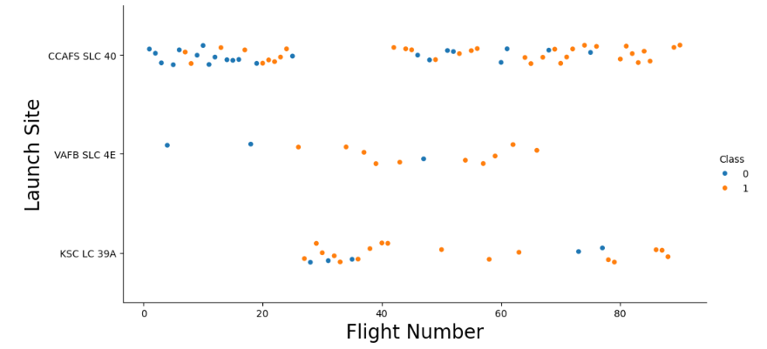
Flight Number vs. Launch Site
Blue dots – fail; orange dots – success;
There’s an increase in the number of orange dots with the Flight number, suggesting an increasing success with time;
It seems that KSC LC 39A and VAFB SLC 4E have higher success rates than CCAFS SLC 40.

Slide 19
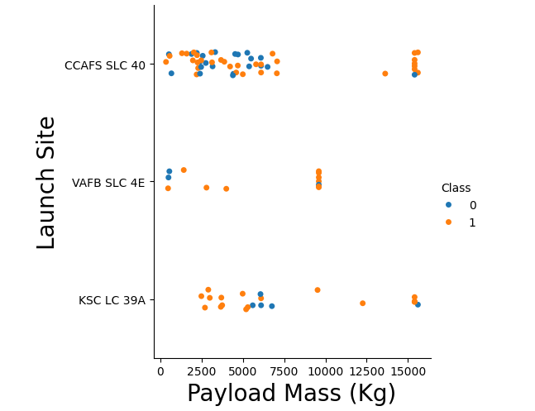
Payload vs. Launch Site
There’s an increase in success rates with the Payload Mass (Kg);
Most launches were done below the 7500Kg threshold.
Above 7500Kg, success rates increase substantially;
Below 5000Kg, KSC LC 39A has 100% success.

Slide 20
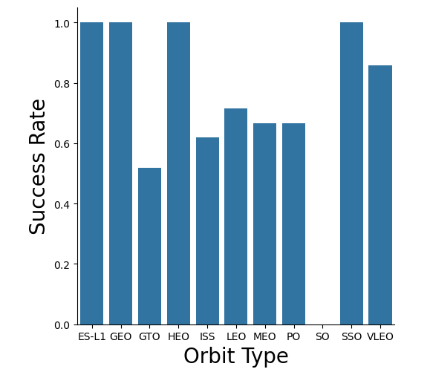
Success Rate vs. Orbit Type
Orbits ES-L1, GEO, HEO and SSO have a success rate of 100%;
On the other hand, SO orbit show 0% of success rate.

Slide 21
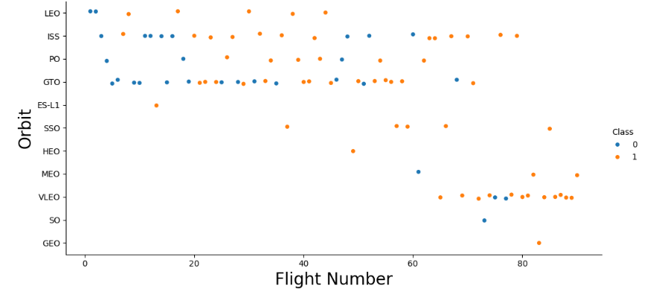
Flight Number vs. Orbit Type
From a general point of view, with the increase in the number of flights, the number os success landings also increases, with the exception being the GTO orbit.
SSO orbit does have a 100% of landing success rate.

Slide 22
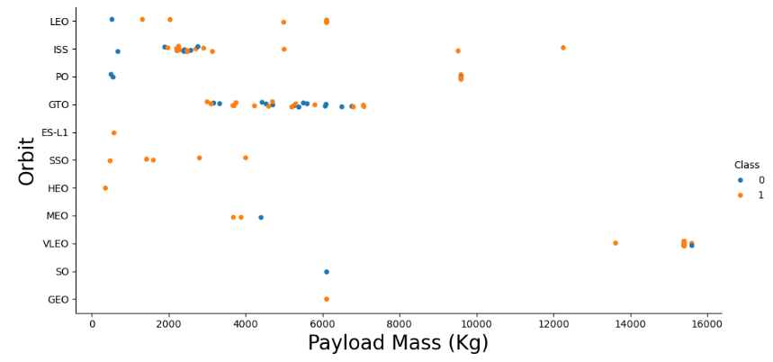
Payload vs. Orbit Type
Overall, with the increase in the Payload Mass (Kg), there’s an increase in the number os successful landings;
GTO orbit seems to be the one where this trend does not occur;
SSO orbit has a successful landing rate of 100%.

Slide 23
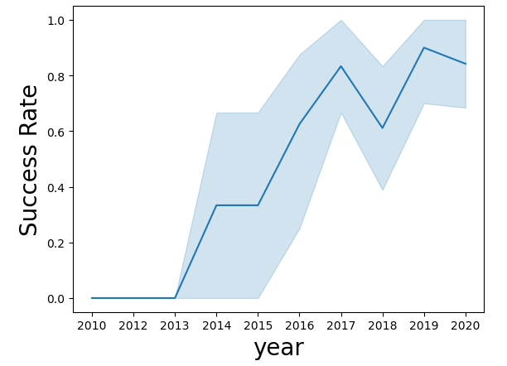
Launch Success Yearly Trend
As time goes by, the success rate increases.

Slide 24
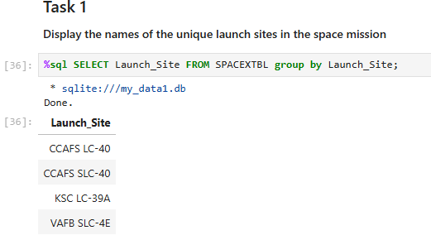
All Launch Site Names
According to the query used, the names of the Launch Sites are:
CCAFS LC-40;
CCAFS SLC-40;
KSC LC 39A
VAFB SLC 4E
I selected the column ‘Launch_Site and grouped by ‘Launch_Site in order to have just the names of the Launch Site;
The query ‘Unique’ didn’t work, I don’t know why.

Slide 25
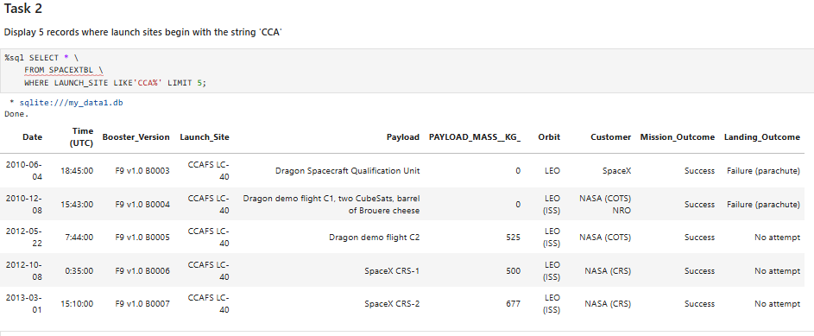
Launch Site Names Begin with 'CCA'

Slide 26
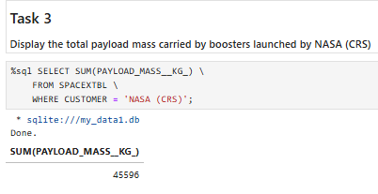
Total Payload Mass

Slide 27
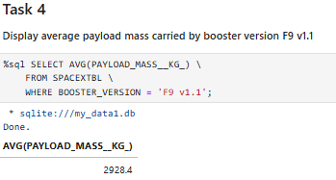
Average Payload Mass by F9 v1.1

Slide 28
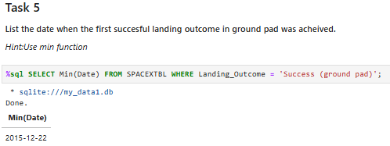
First Successful Ground Landing Date

Slide 29
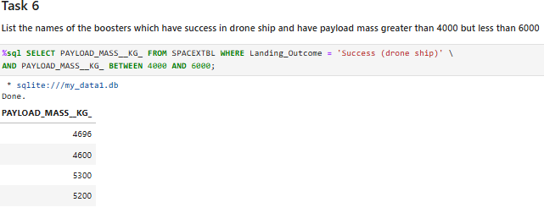
Successful Drone Ship Landing with Payload between 4000 and 6000

Slide 30
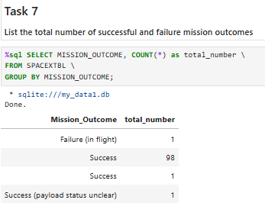
Total Number of Successful and Failure Mission Outcomes

Slide 31
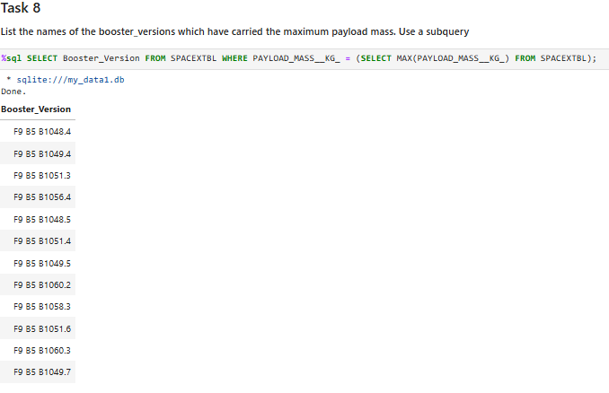
Boosters Carried Maximum Payload

Slide 32
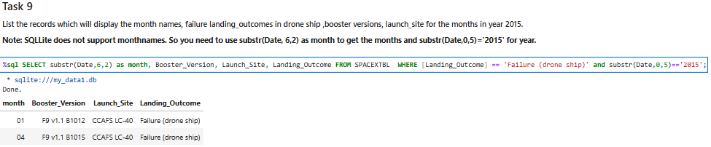
2015 Launch Records

Slide 33
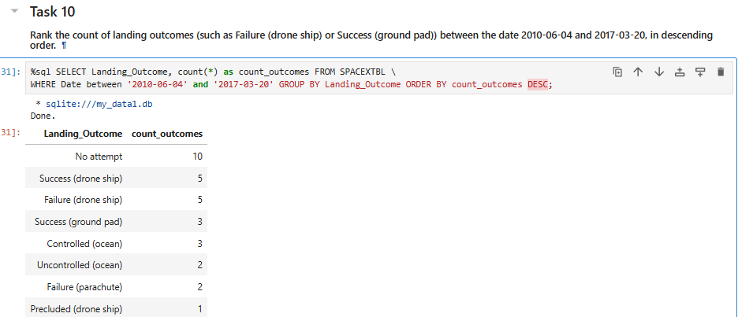
Rank Landing Outcomes Between 2010-06-04 and 2017-03-20

Slide 34

Section 3

Slide 35
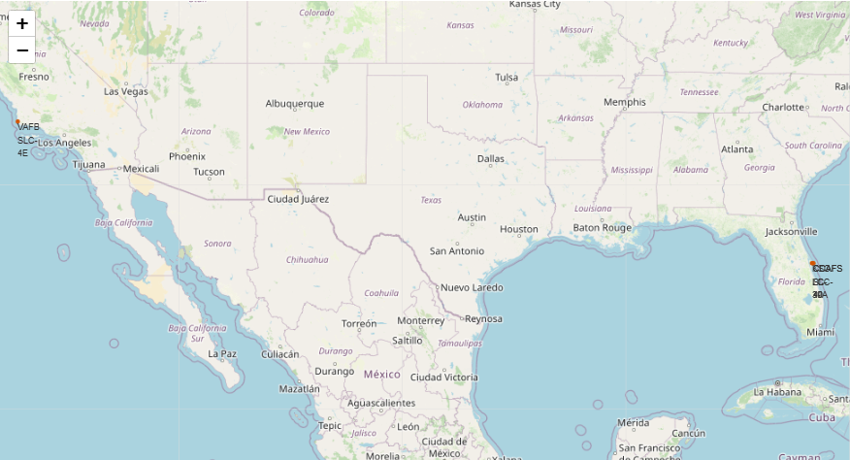
Launch Sites
From the map, we can see that the location sites are on both sides of the American southern coast, relatively closed to the Equator. This helps saving costs in fuel consumption, since launching closer to the Equator you have higher initial speed thanks to Earth’s rotation.

Slide 36
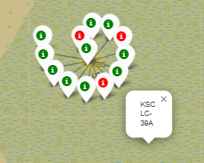
Launch Outcomes at KSC LC-39A
Most launch outcomes at KSC LC-39A are in green, showing high rates of successful launches – 10/13, corresponding to almost 77%.

Slide 37
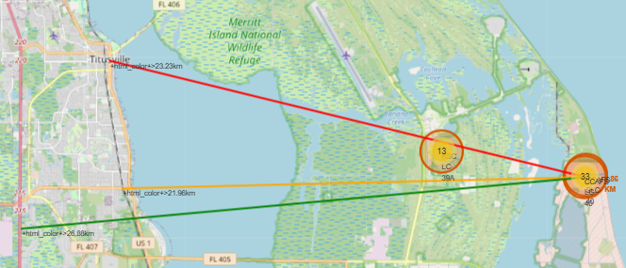
Distance to proximities from CCAFS SLC-40
Distance to the city: 23.34Km
Distance to railway: 21.96Km
Distance to Highway: 26.88Km
Distance to coastline: 0.86Km

Slide 38

Section 4

Slide 39
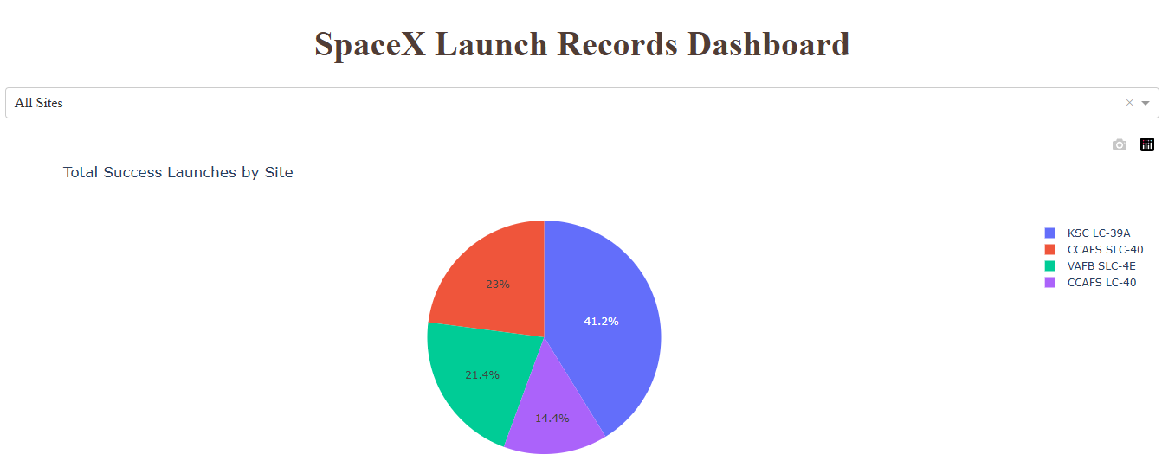
Launch Success
KSC LC-39A is the site with more launch sites, with 41% of them being successful.
On the other hand, CCAFS LC-40 is the site with less successful launches with 14.4%.

Slide 40
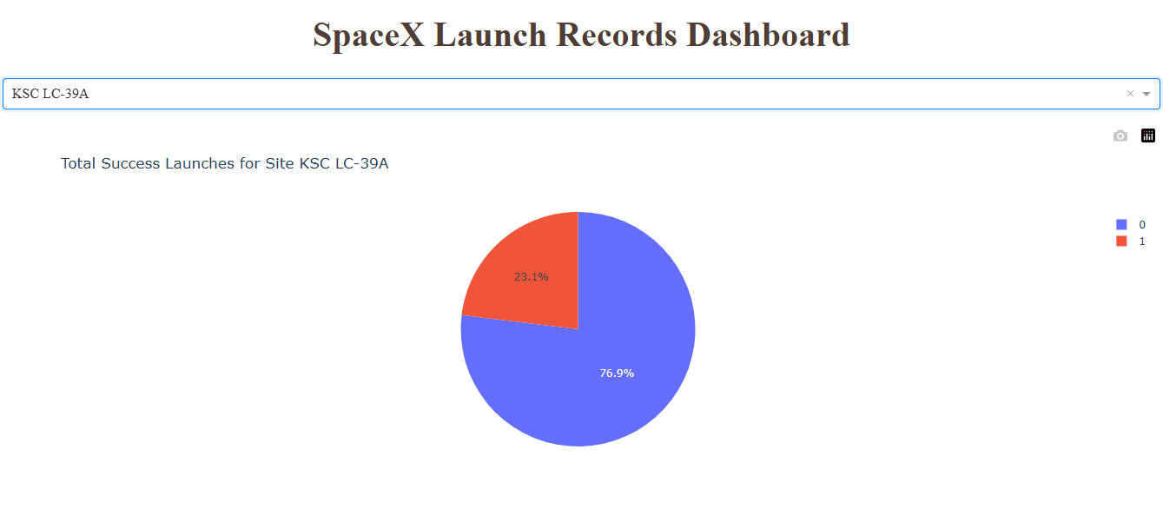
Launch Success Rate of KSC LC-39A
Site KSC LC-39A has a success rate of almost 77%.

Slide 41
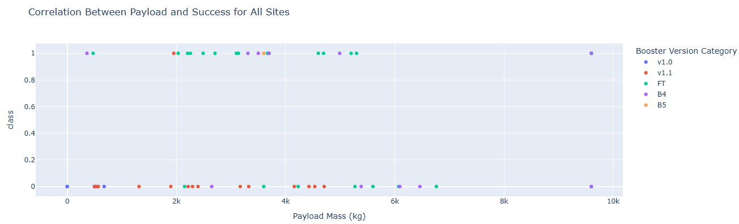
Success by Payload Mass (Kg) and Booster Version
Best Payload Mass (Kg) range is between 2000 and 4000.
Best Booster Version is FT, which is the one in green.

Slide 42

Section 5

Slide 43
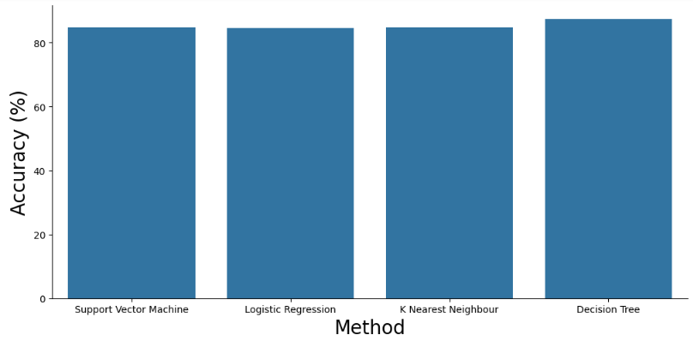
Classification Accuracy
Decision Tree Classification method is slightly better than the other 3, with 87% accuracy.

Slide 44
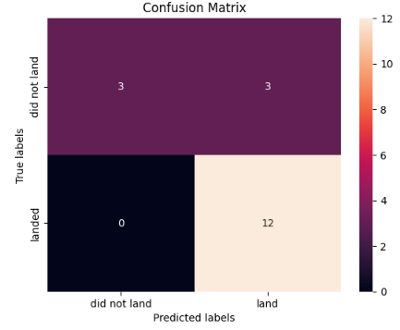
Confusion Matrix
Confusion matrices are useful to syn- thesize a model’s performance;
False Positives are a Type 1 Error;
We have:
12 True Positives
0 False Negatives
3 False Positives
3 True Negatives

Slide 45
Conclusions
Launch site KSC LA-39A is the best launch site of them all;
Orbits ES-L1, GEO, HEO and SSO have a success rate of 100%;
Launch sites are all near the coast so the debris falls into the water, and near the equator to make the most of earth’s rotational speed, saving fuel costs;
There’s an increase in launch success with the passing of time;
Best classification method is Decision Tree, having slightly better results than the other methods.

Slide 46


